Slide 1
Meeting 15/06/2020
Naudé Conradie
19673418

Slide 2
Code
Size specification
Boundary thickness specification
Pickling
Unit class objects
Unit performance verification
Apply internal pressure
Evaluate results
Multiple loadcases and jobs

Slide 3
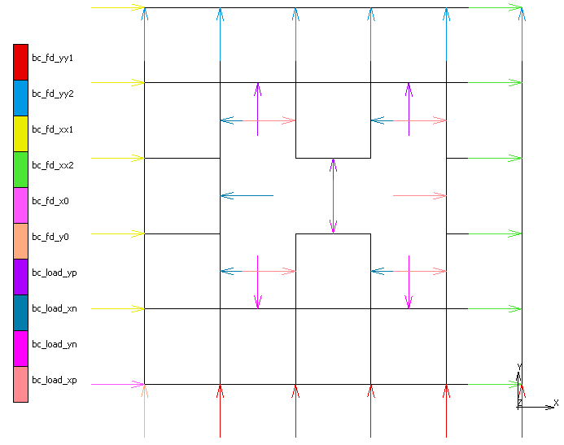

Slide 4
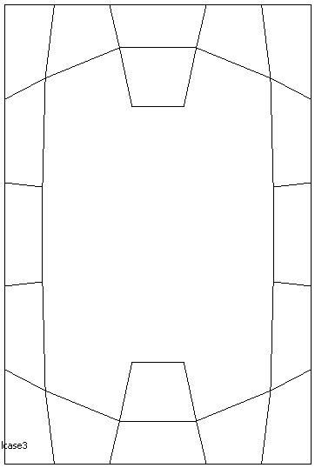
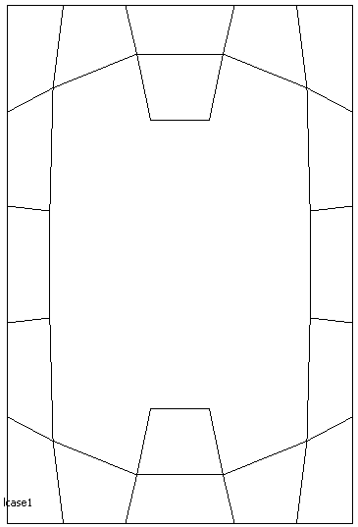

Slide 6
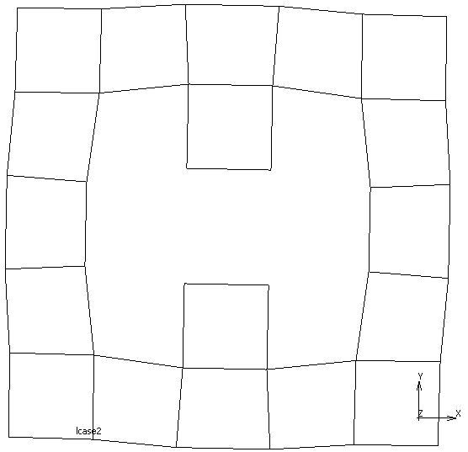
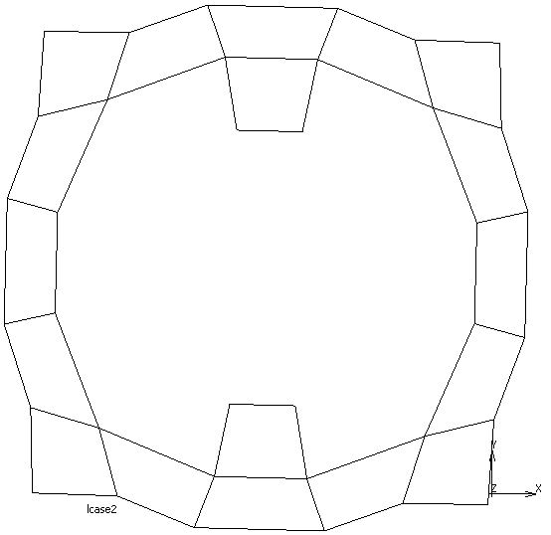

Slide 7
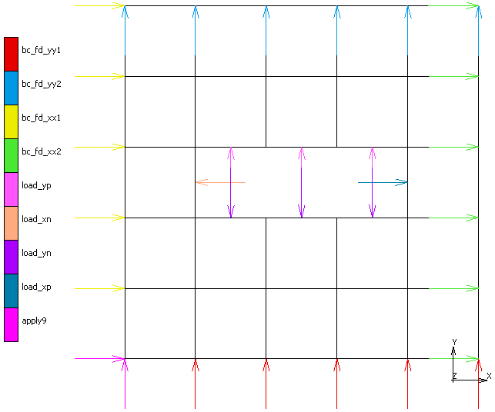

Slide 8
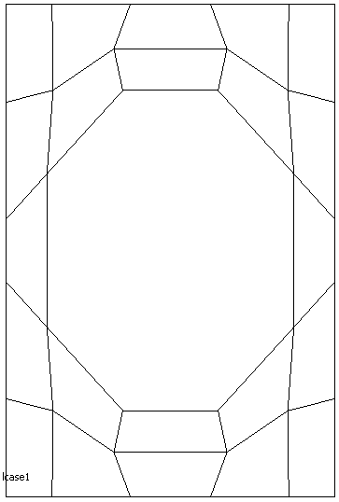

Slide 9
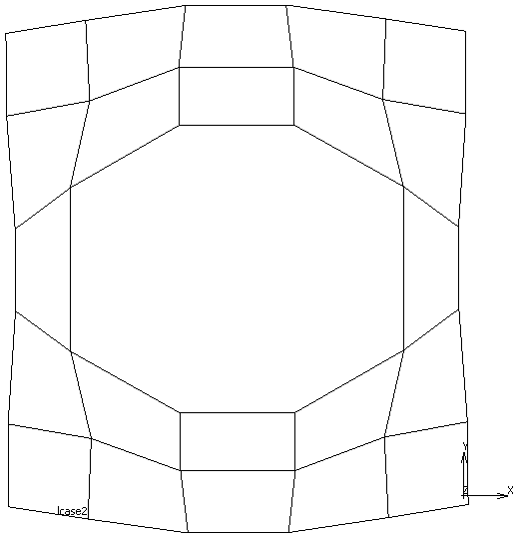

Slide 10
Admin
Demi 2nd semester

